Slide 1

Homework
Boyang Li Jiaheng Xie Hanfei Yang

Slide 2
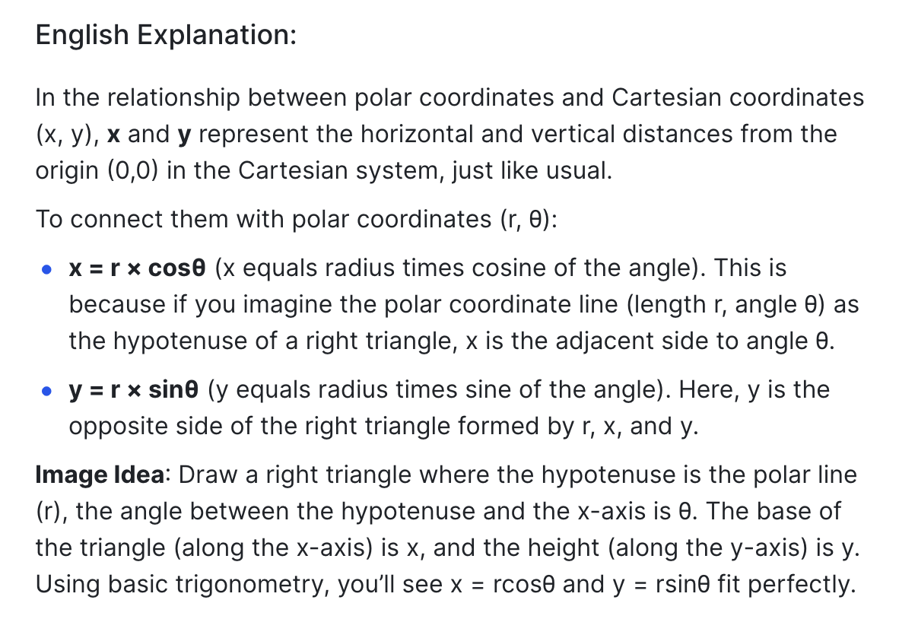
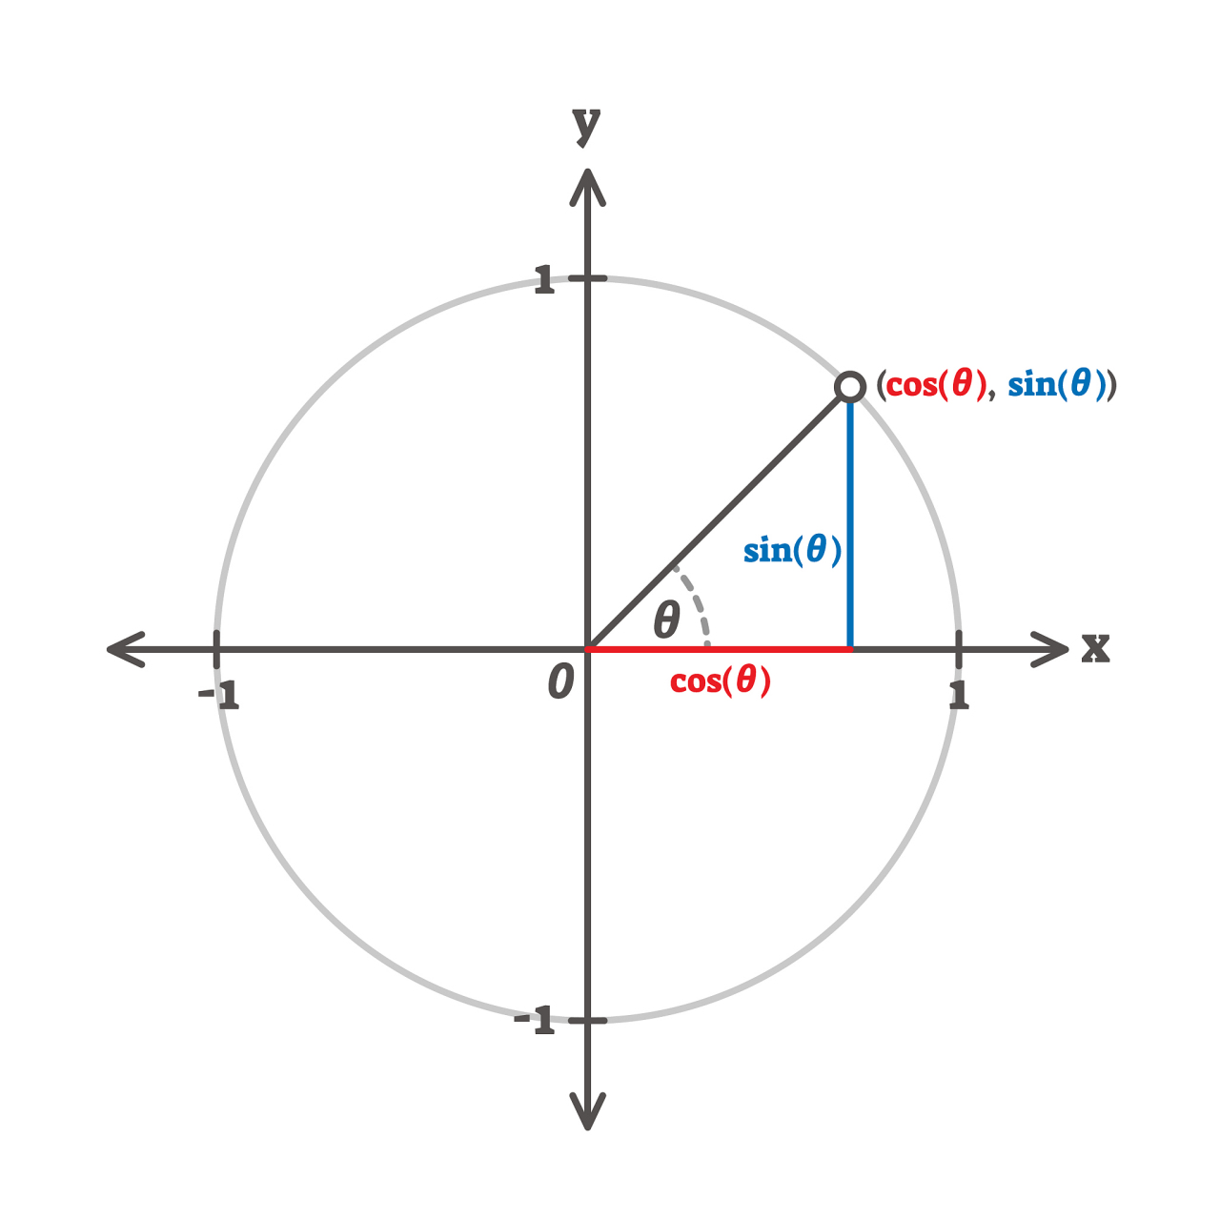
polar coordinates

Slide 3

4 Params Animals Display:Abstract version
#Corn cannon
Parameters=[50+20j, 20-40j, 18+30j, -16-55j, 40+10j]

Slide 4

4 Params Animals Display:Abstract version
#shrimp
Parameters=[0-20j, 30+10j, 30+20j, 20-50j, -35+13j]

Slide 5
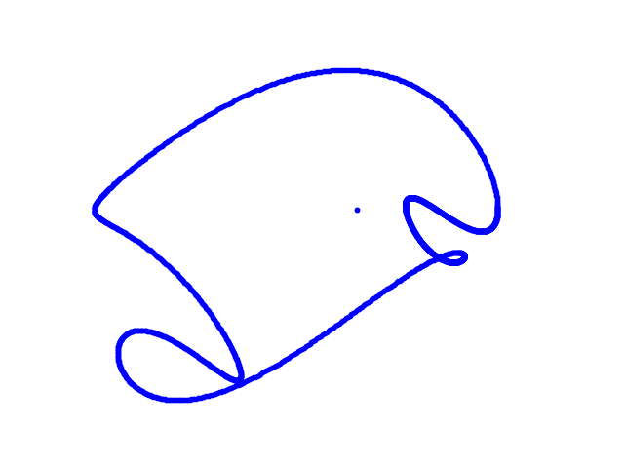
4 Params Animals Display:Abstract version
#whale
Parameters=[50-30j, 15+10j, 12+30j, -14—50j, 30+20j]

Slide 6
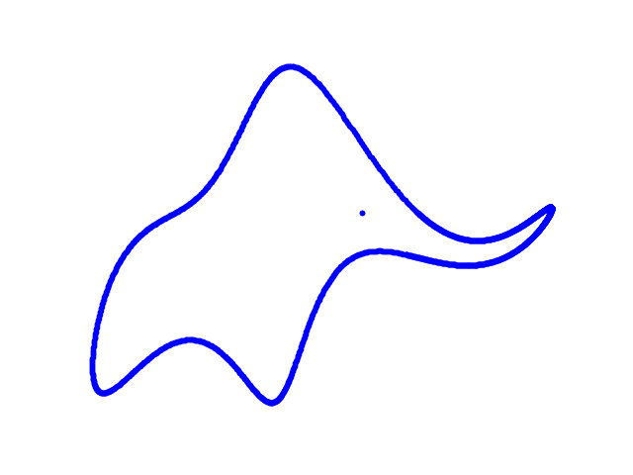
4 Params Animals Display:Abstract version
#elephant
Parameters=[50-30j, 18+8j, 12-10j, -14—60j, 20+20j]

Slide 7
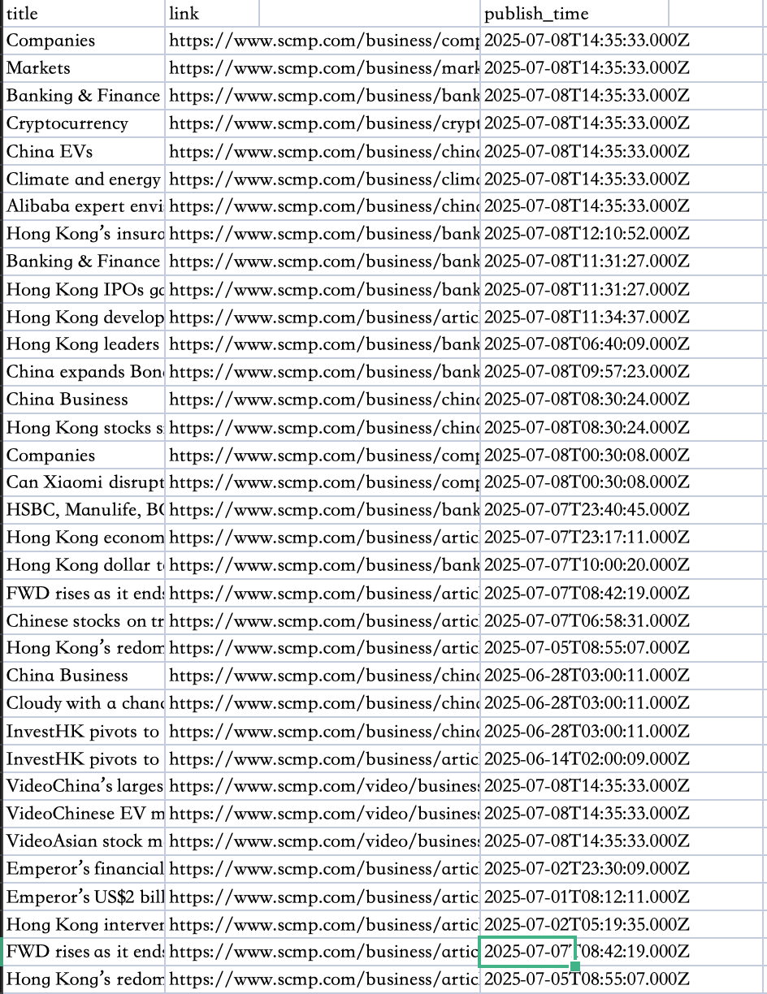
Scrape South China Morning Post

Slide 8
Random Forest
Beer Tasting Master System
This Python-based interactive system recommends the perfect beer for you!
By answering six simple preference questions, you receive a data-driven beer style recommendation, a specific beer suggestion, fun facts, and food pairings—plus an automatically generated personalized "Beer Passport" image.
The system combines simulated beer data, decision tree modeling, and visual design to make learning about beer styles engaging and practical.

Slide 9
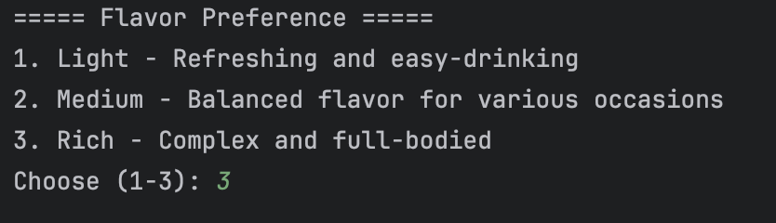
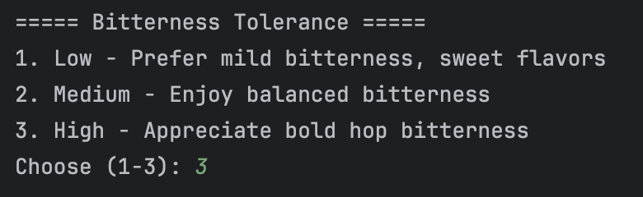
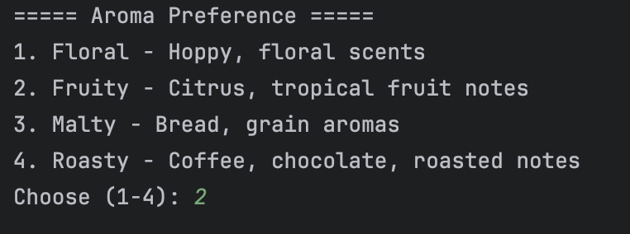
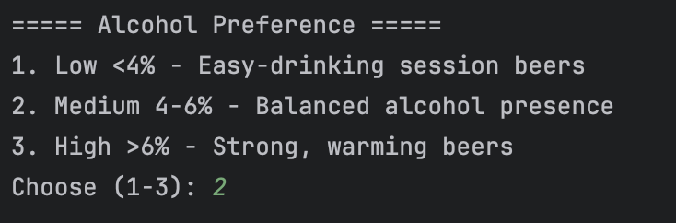
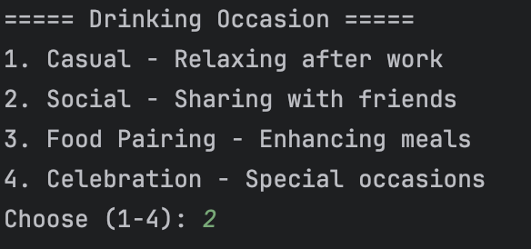
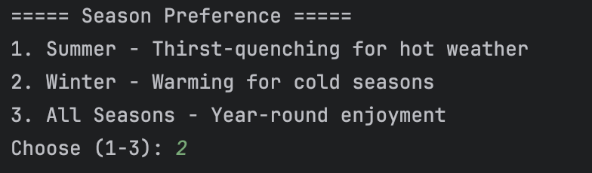
selection process

Slide 10
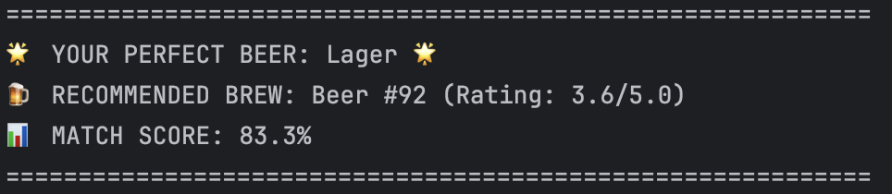
Final result
In this example, your perfect beer is Lager, with a high match score of 83.3% (model confidence).
The system recommends a specific beer from the dataset—Beer #92 (Rating: 3.6/5.0)—and provides style characteristics, a fun fact, and ideal food pairings.
This interactive process personalizes beer selection and helps you explore the world of beer in an engaging way.

Slide 11
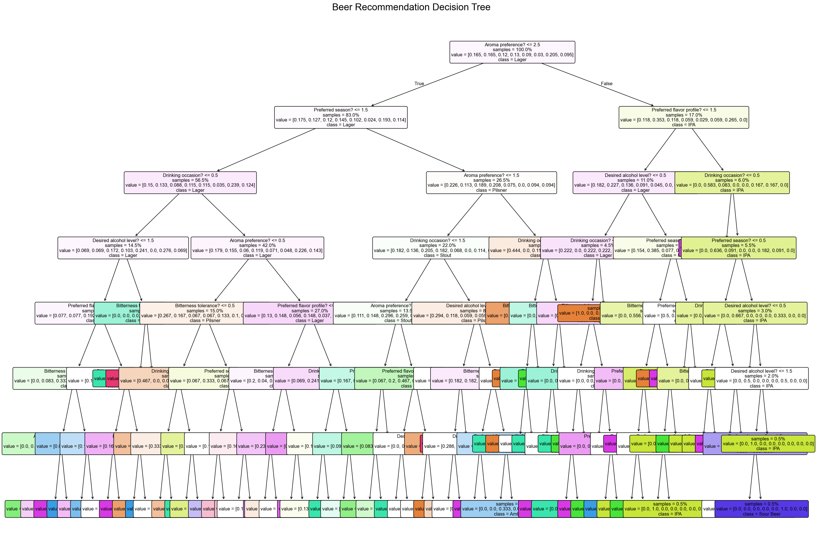
Decision tree

Slide 12
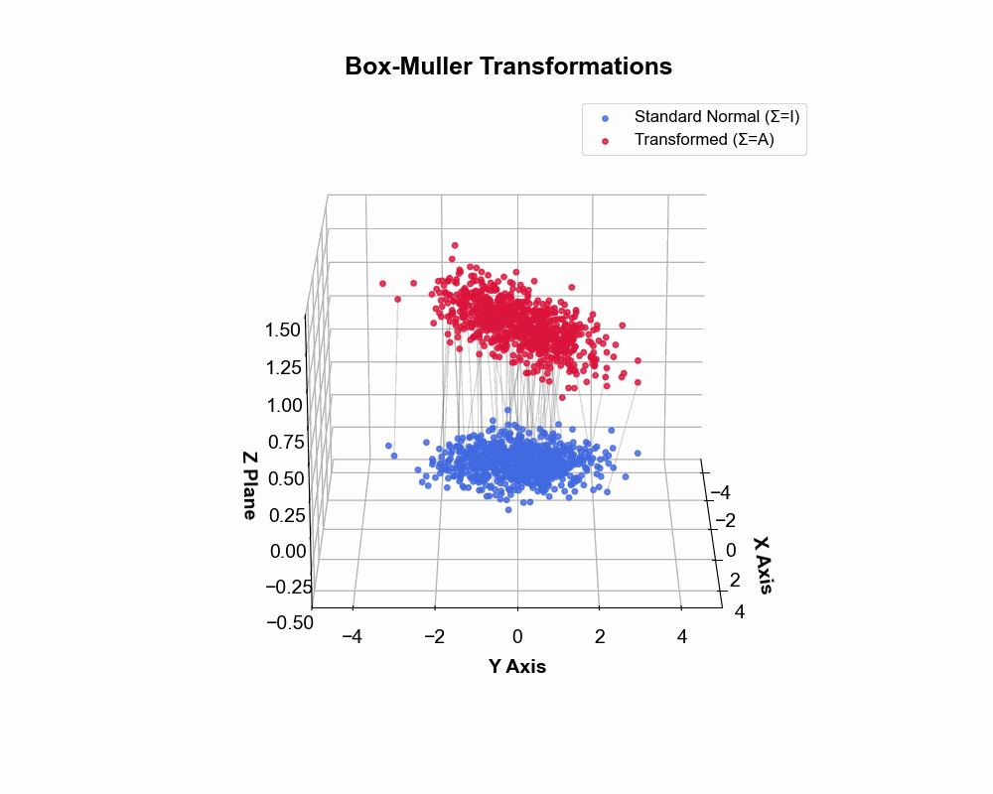
3D_picture

Slide 13
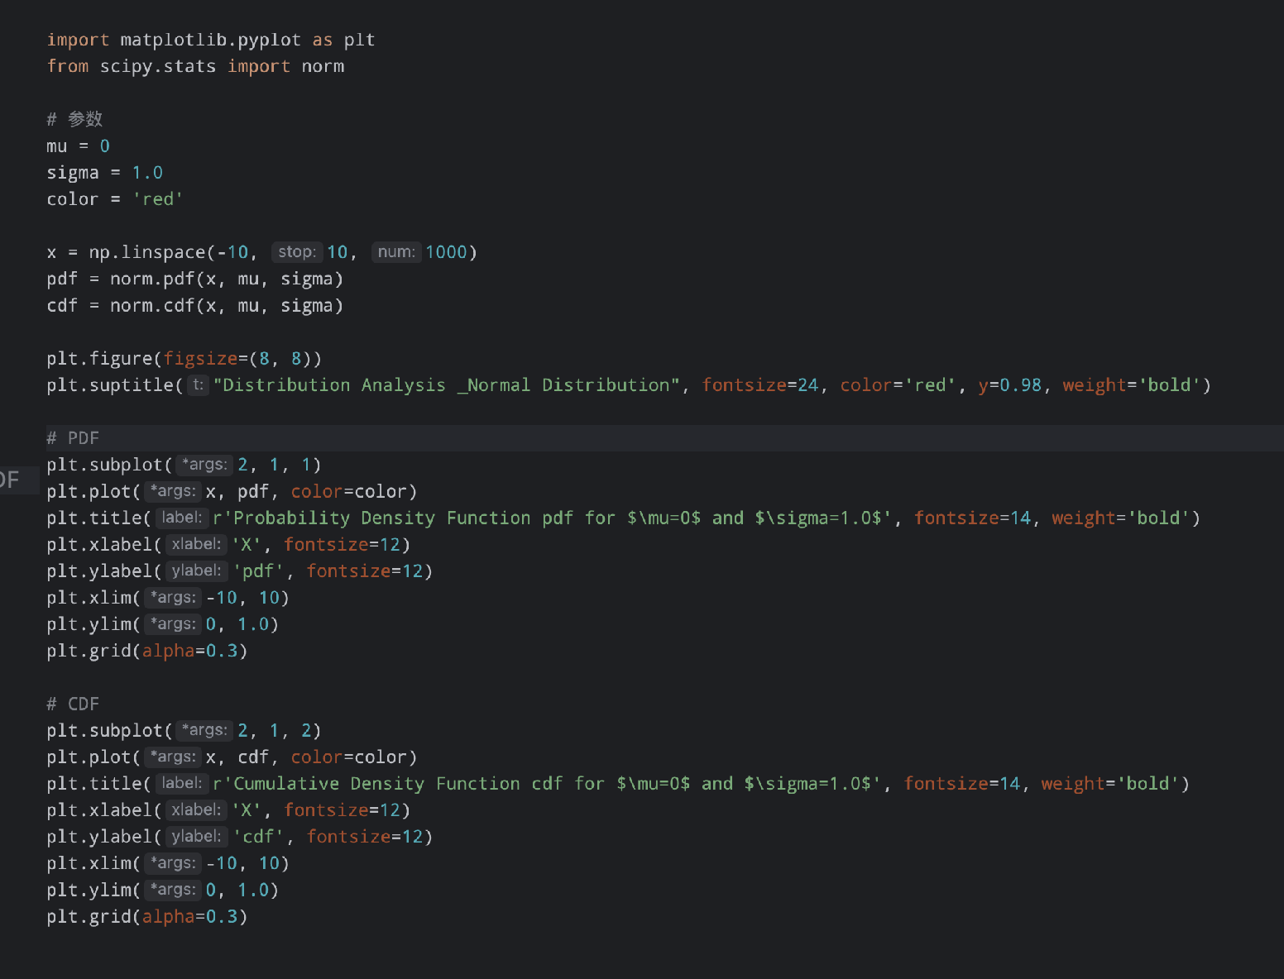
code

Slide 14
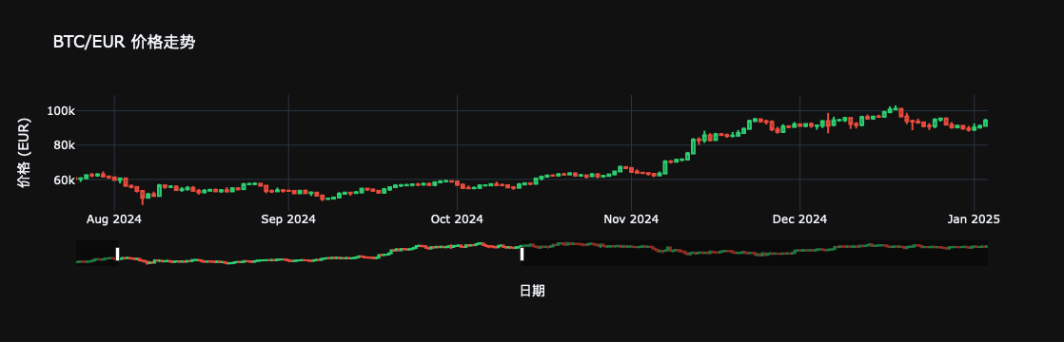
BTC

Slide 15
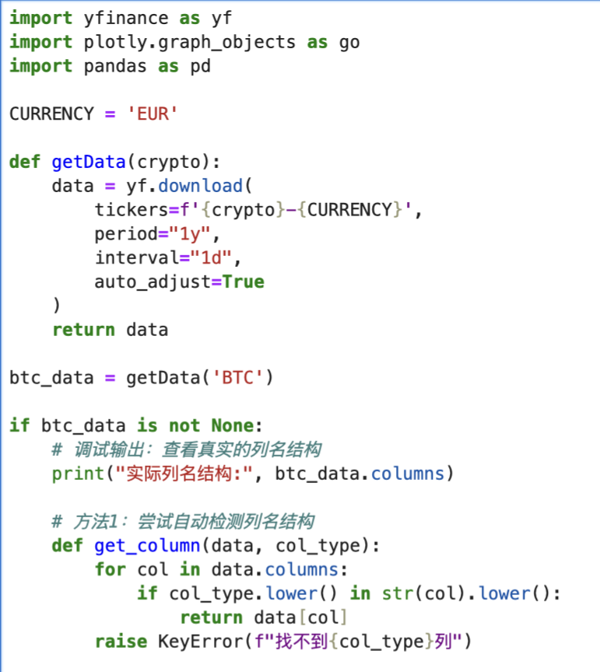
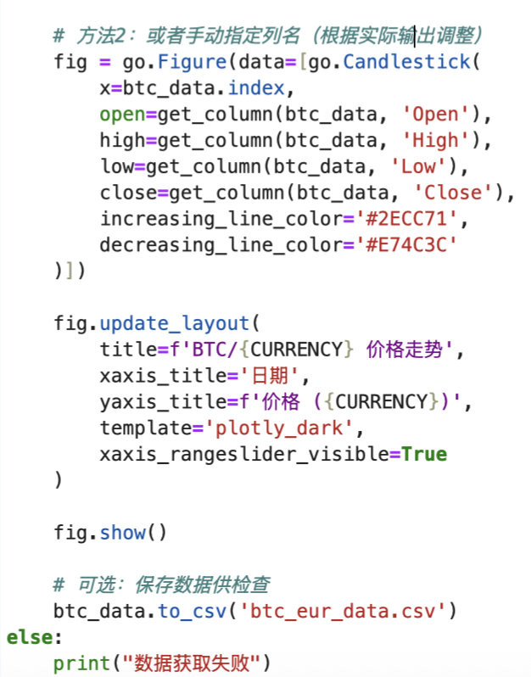
code

